Slide 1
Activity Recognition from Sensors
Adapted from presentation
Xing Su , HanghangTong

Slide 2
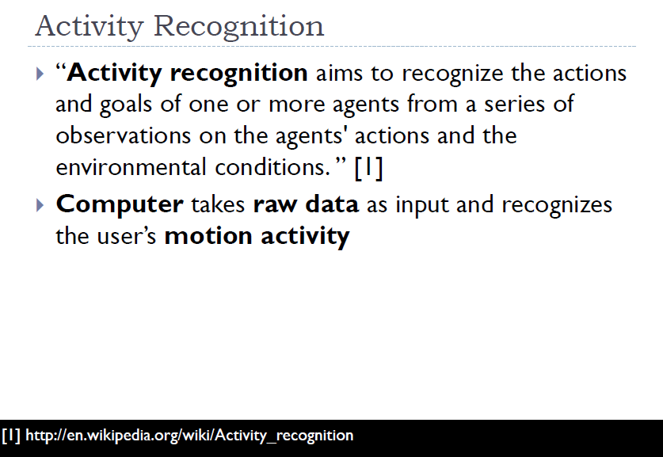

Slide 3
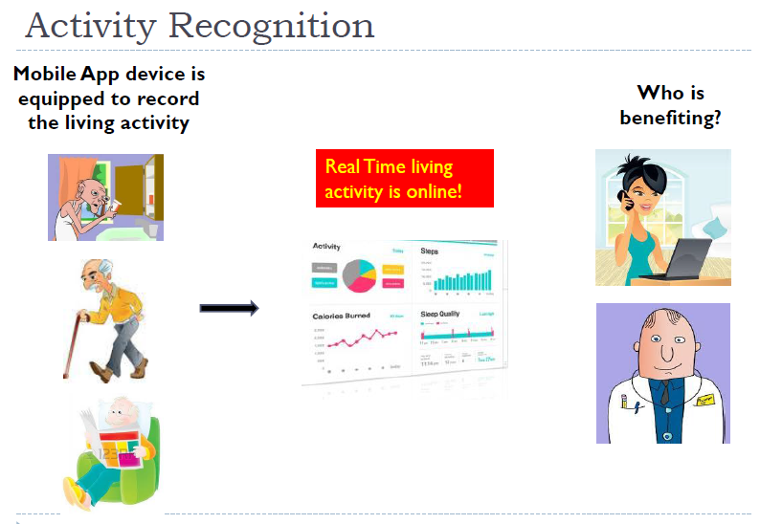

Slide 4
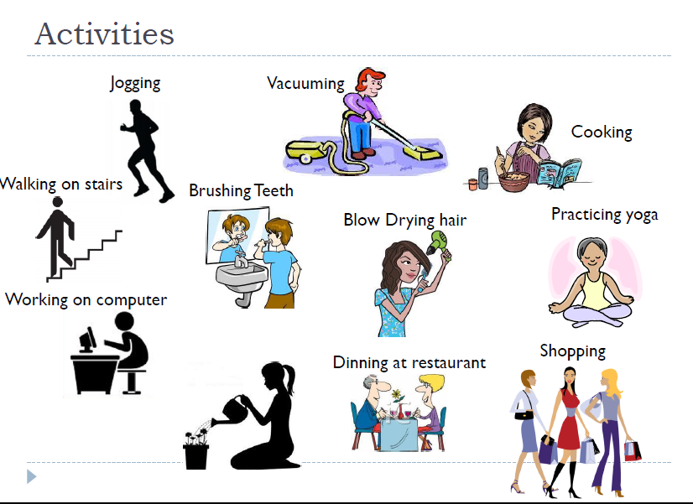

Slide 5
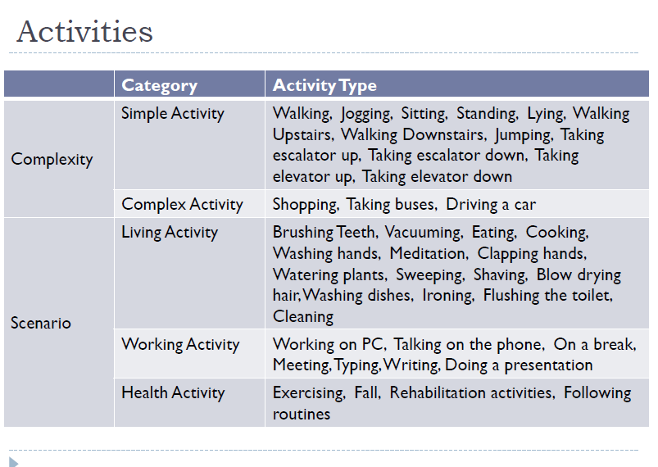

Slide 6
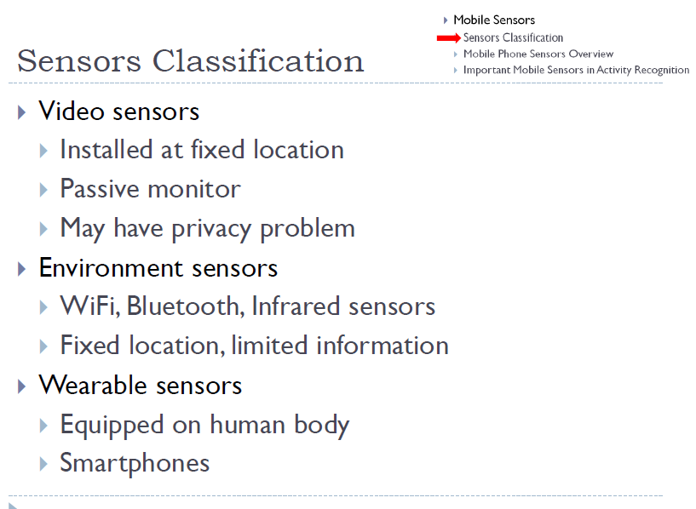

Slide 7
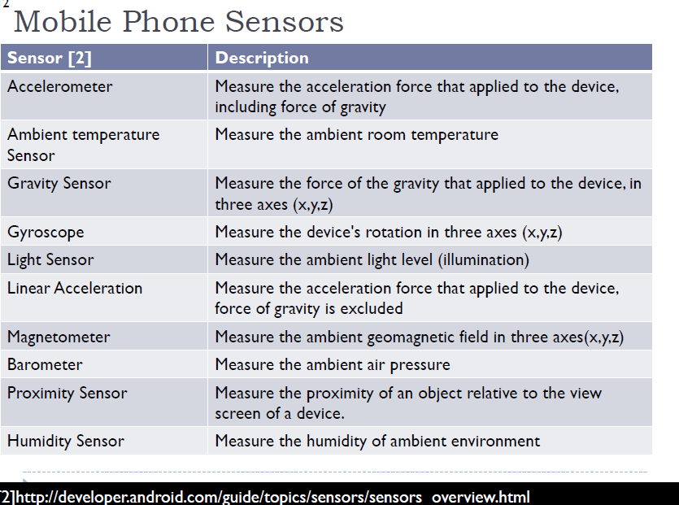

Slide 8
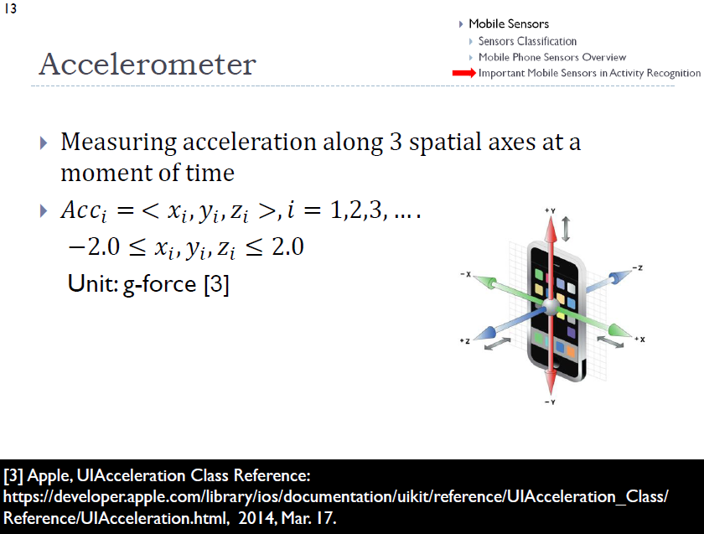

Slide 9
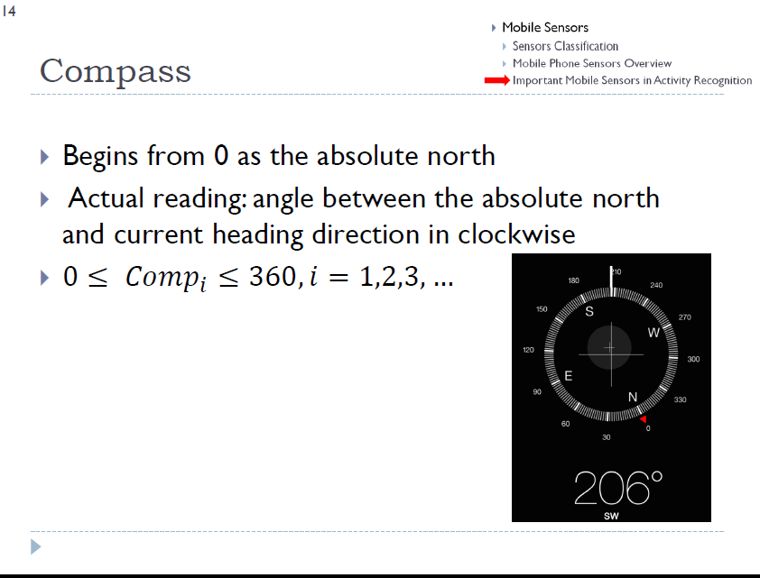

Slide 10
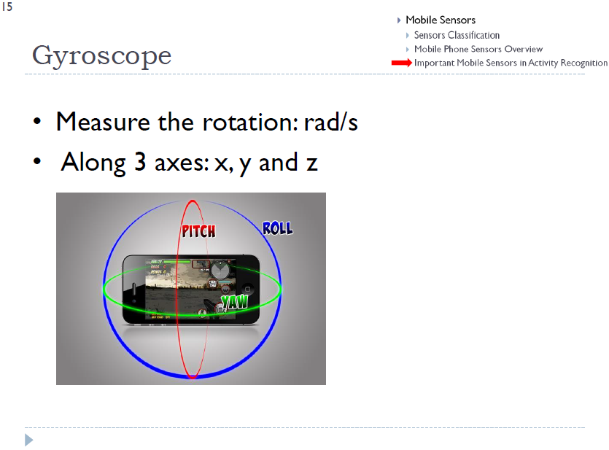

Slide 11
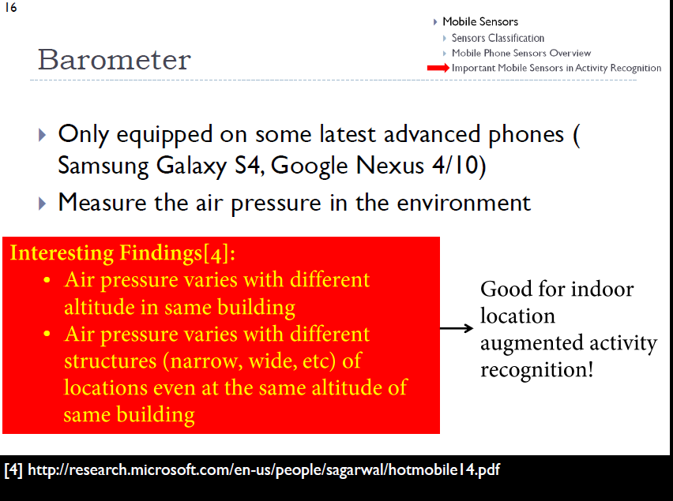

Slide 12
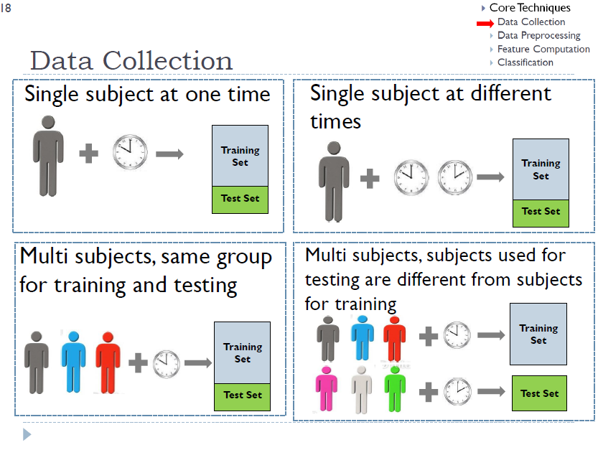

Slide 13
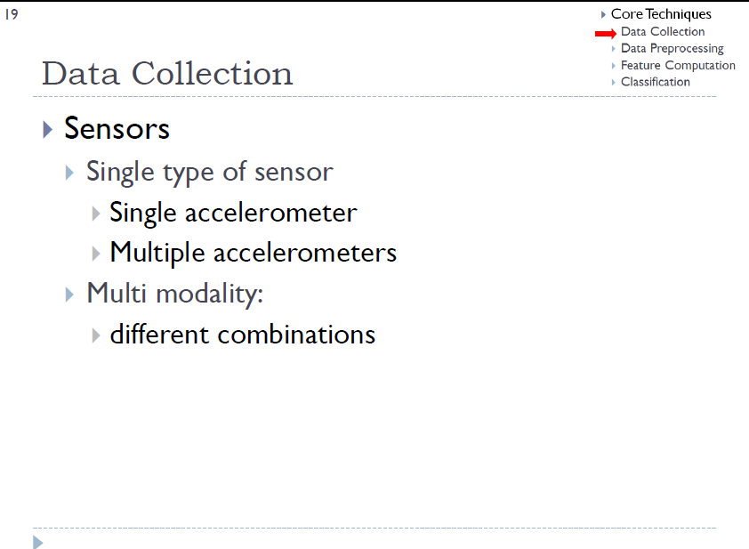

Slide 14
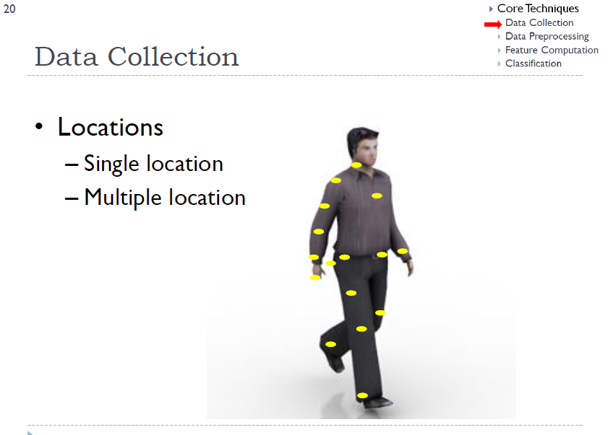

Slide 15
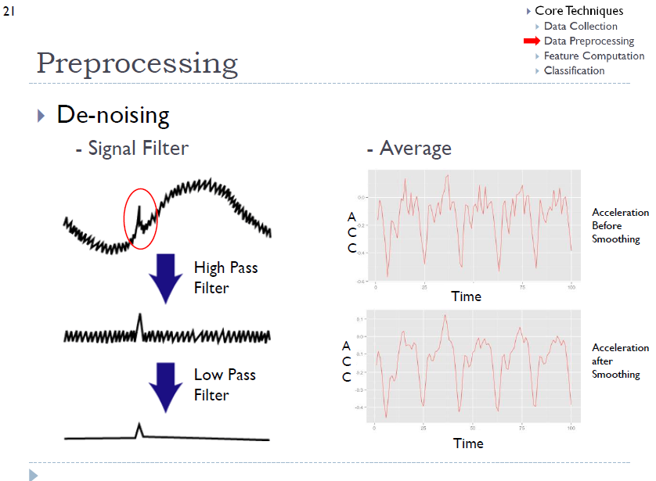
http://stackoverflow.com/questions/24119672/android-low-pass-filter-and-high-pass-filter
https://www.built.io/blog/applying-low-pass-filter-to-android-sensor-s-readings

Slide 16
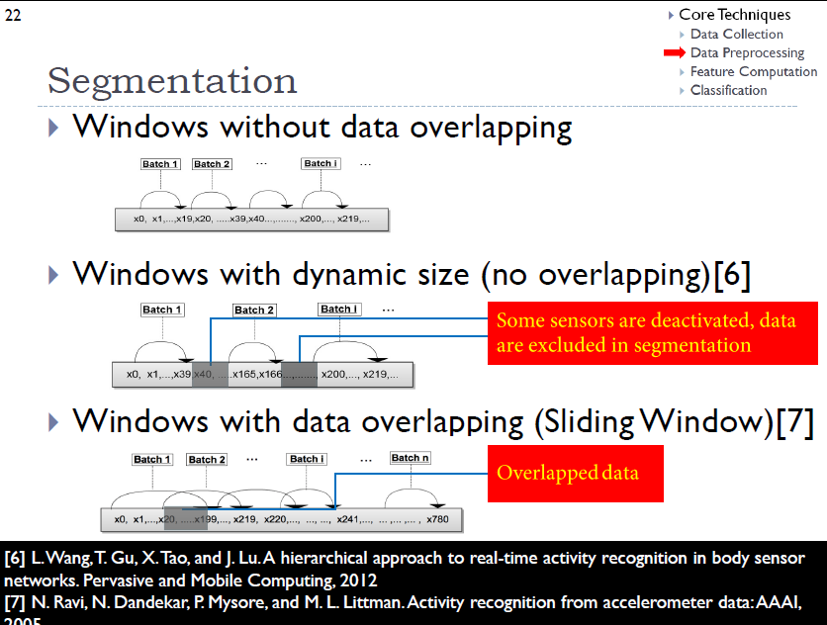

Slide 17
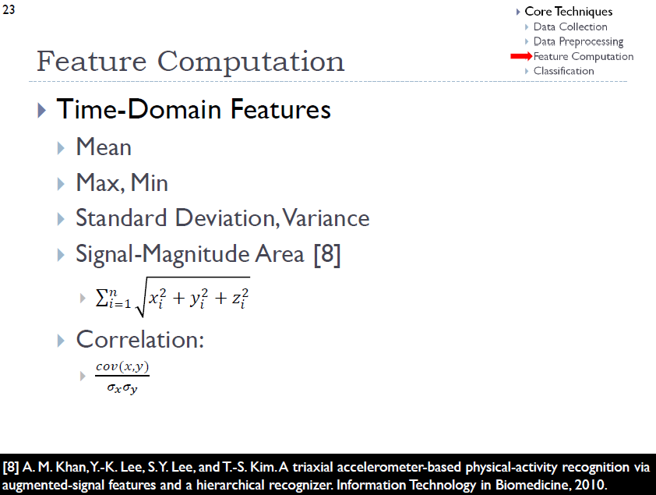
https://tyangluhtu.wordpress.com/2013/04/11/apakah-covariance/

Slide 18
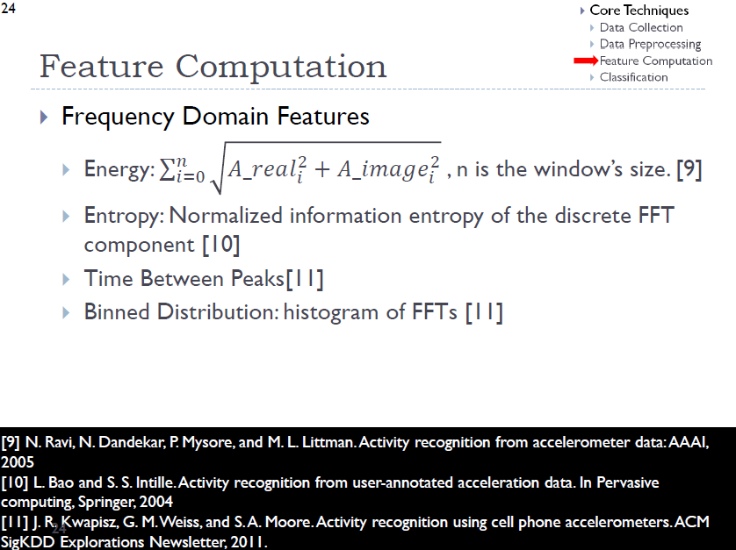
Analysis of Time and Frequency Domain Features of Accelerometer Measurements Waltenegus Dargie Chair for Computer Networks, Faculty of Computer Science Technical University of Dresden 01062 Dresden, Germany

Slide 19
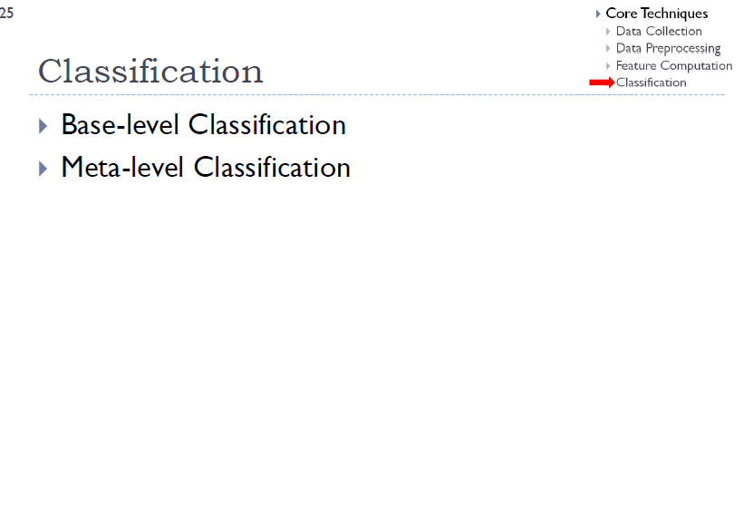

Slide 20
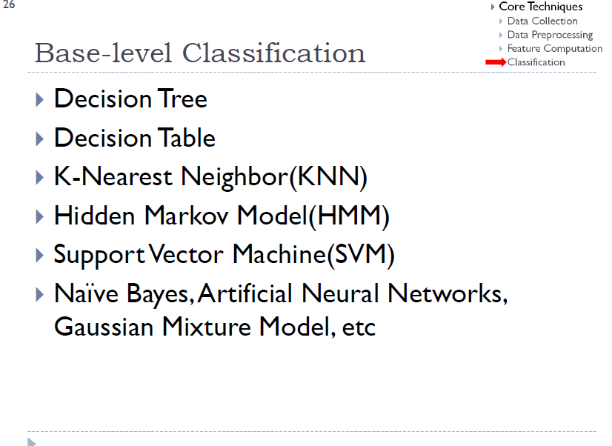
WEKA FOR ANDROID !!
OPEN CV FOR ANDROID !!
Others ?

Slide 21
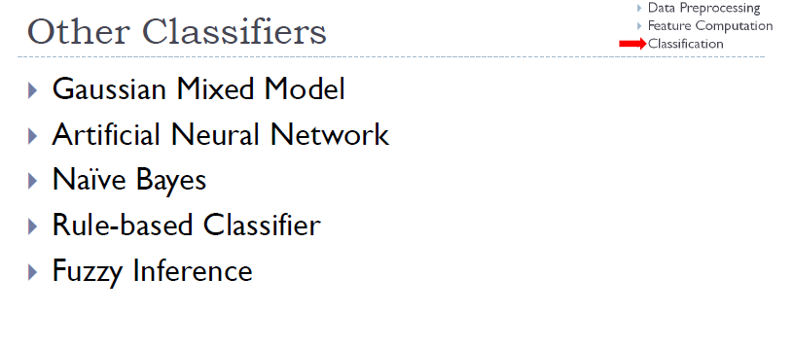
Fuzzy for Android ?
Fuzzy for Arduino

Slide 22
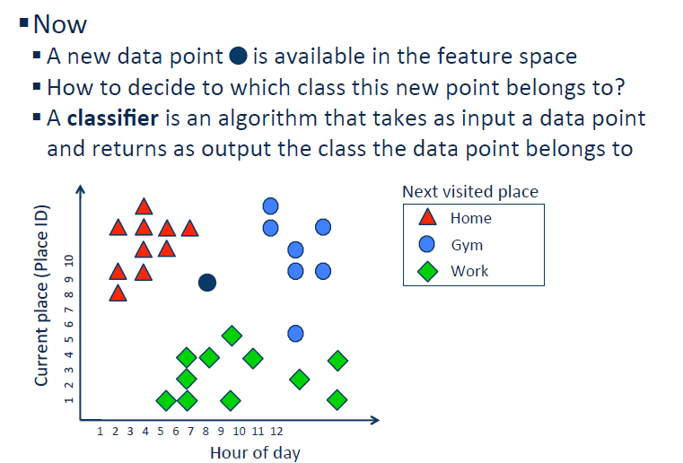
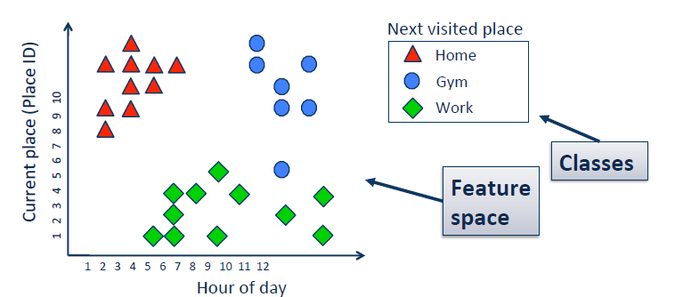
Classification

Slide 23
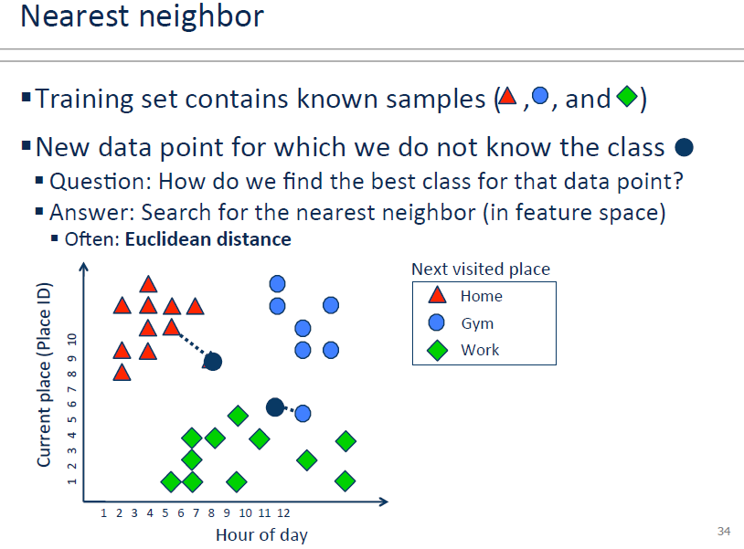

Slide 24
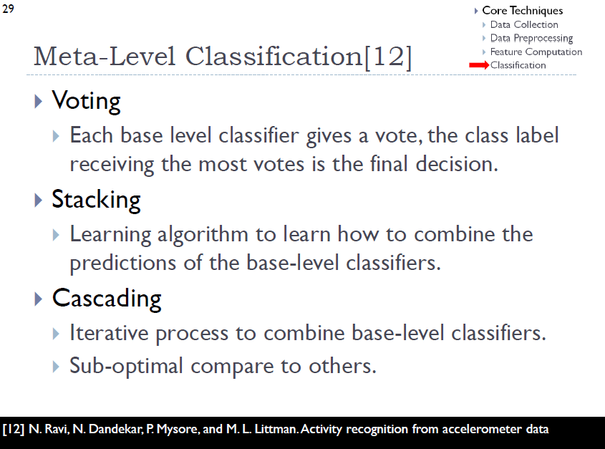

Slide 25
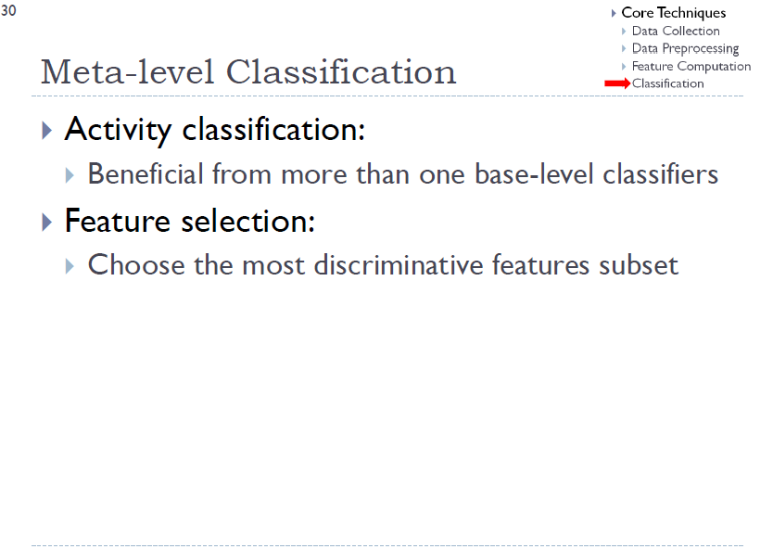

Slide 26
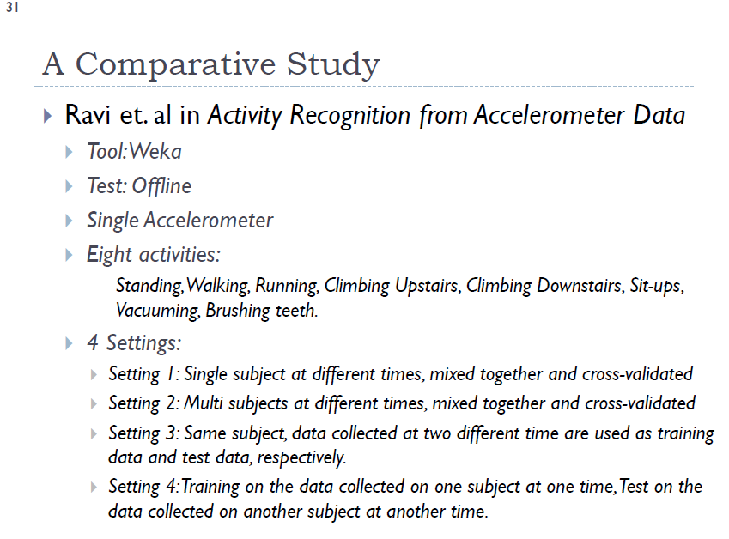

Slide 27
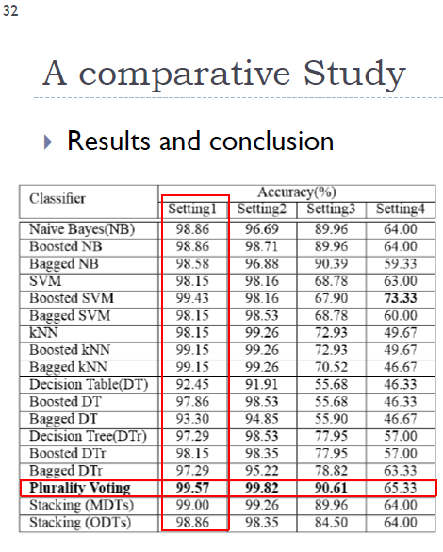

Slide 28
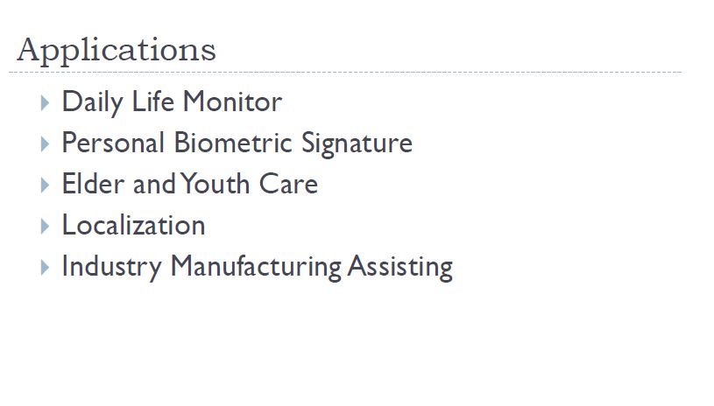
Activity Recognition

Slide 29
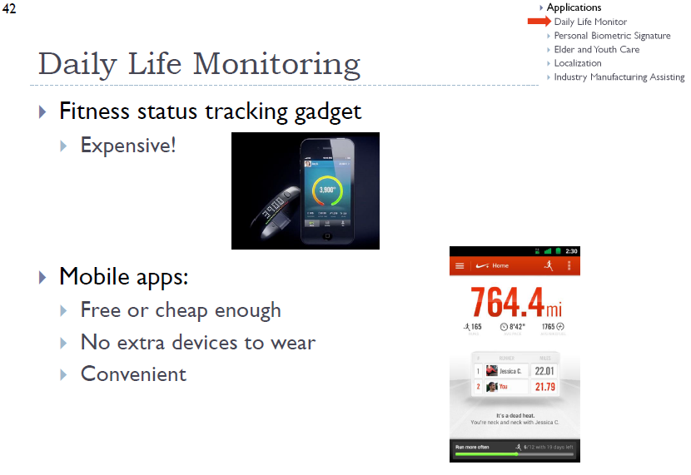

Slide 30
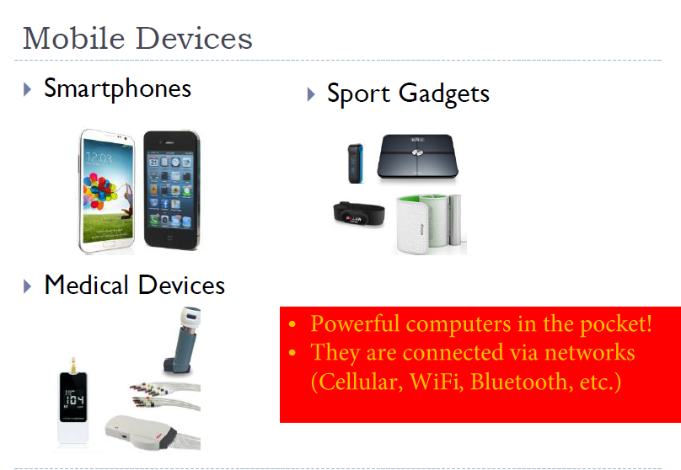

Slide 31
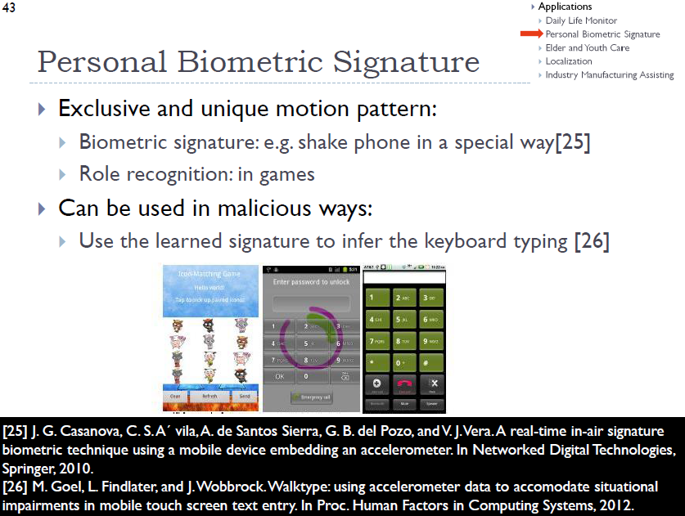

Slide 32
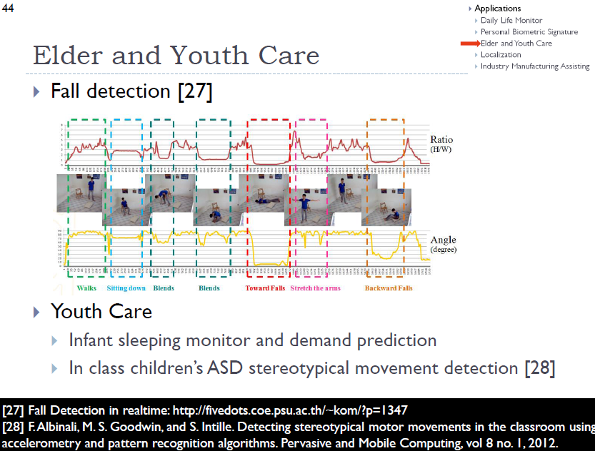

Slide 33
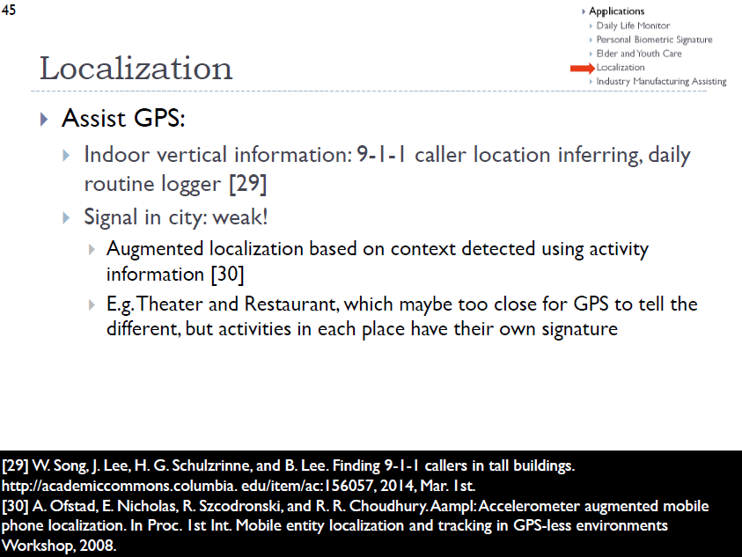

Slide 34


Slide 35
OWARI/END/TELAS

